Slide 1

SENTIMENT ANALYSIS
Mentor: Ms. Munmun Bhaghat
Team Number: 06
Teammates: Akshay KS
Chetangouda Patil
Jeswyn Moses A
Karan R
Kishore Kumar H B
Vinayak Bakale
Vinutha BN

Slide 2
Business Problem:
Product of interest: iPhone 7
Considerable failure rate of iPhone 7, over the second and first quarters of 2017 and 2018, respectively.
Despite the people’s unlikeliness towards the product, the product’s failure rate hasn’t superseded 8% (which is the maximum), by the first quarter of 2018, which is due to vast range of positive opinions from users
Thus, the product → iPhone 7
The classification technique chosen for this problem – Support Vector Machines
Objective:
The objective of the analysis is to predict:
What is the probability that customer would file fraudulent / Genuine warranty
To understand important factors associated with them.

Slide 3
Project Architecture / Project Flow
Data Acquisition
EDA and Feature Extraction
Sentiment Analysis
Prepare & Train the model
Evaluate Model
Deployment

Slide 4
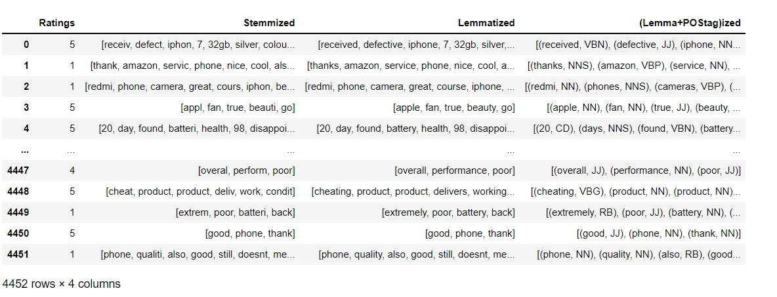
Data Set Details:
Rows: 5352
Columns: 6
Date ranges: 16/09/2016 to 27/04/2021
Missing values: 900

Slide 5
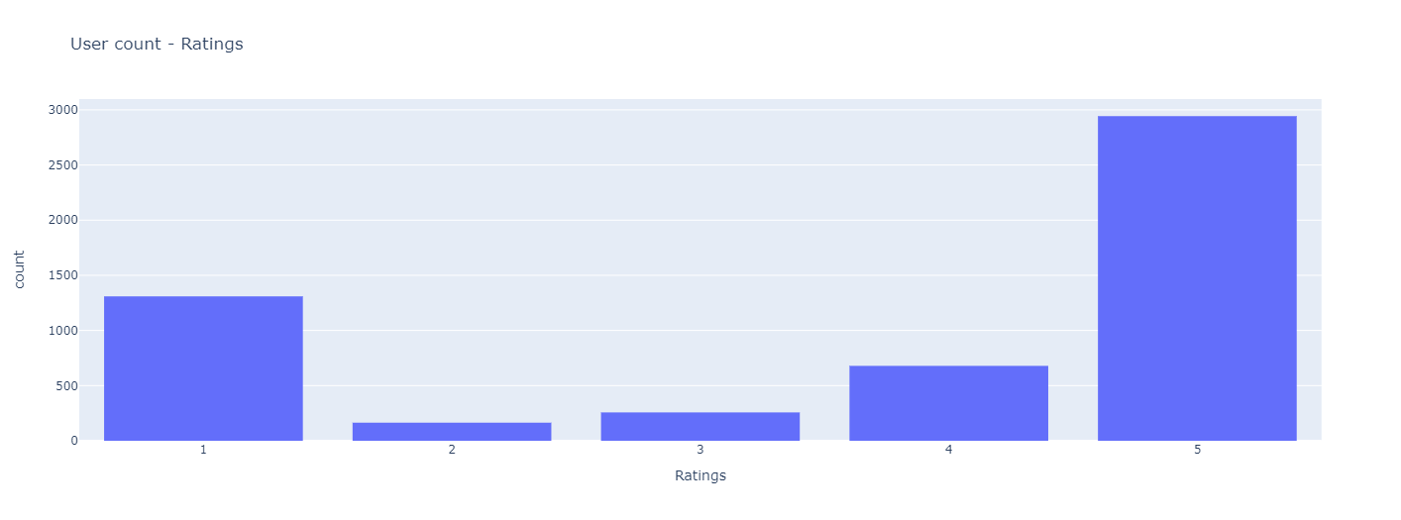
Exploratory Data Analysis (EDA) and
Feature Engineering

Slide 6
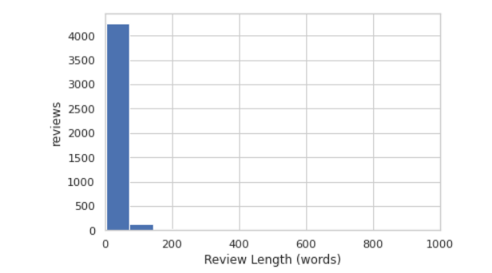
Exploratory Data Analysis (EDA) and
Feature Engineering

Slide 7
Exploratory Data Analysis (EDA) and
Feature Engineering

Slide 8
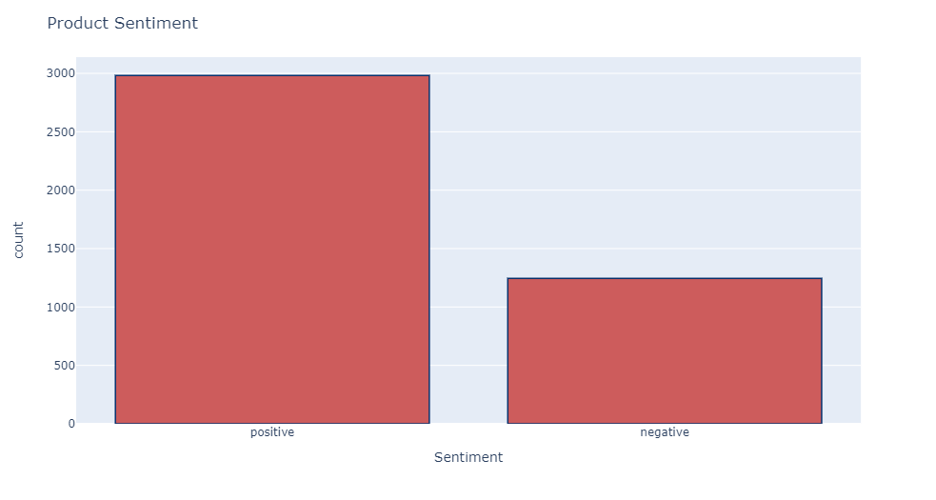
Sentiment Analysis

Slide 9
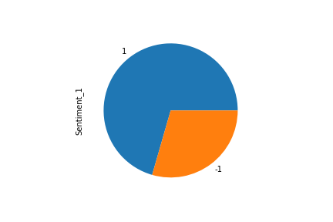
Sentiment Analysis

Slide 10
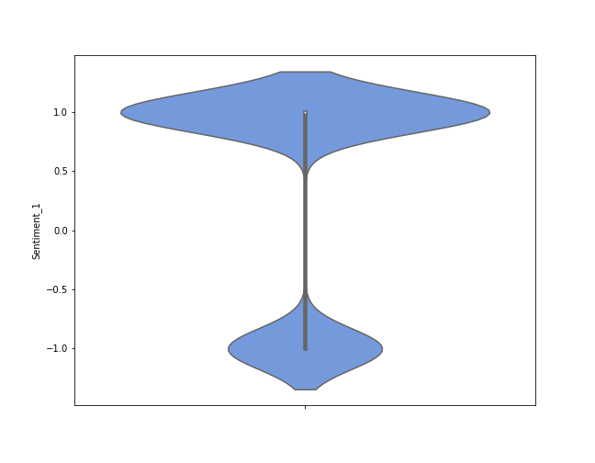
Sentiment Analysis

Slide 11
Model Building

Slide 12
Template for Model results presentation
Model - SVM
Algorithms
(explain the algorithm)
Data set details
Algorithm details and configuration
Data Partition details
Accuracy:
Class wise accuracies
Recall
Precision
F1 score
Etc..

Slide 13
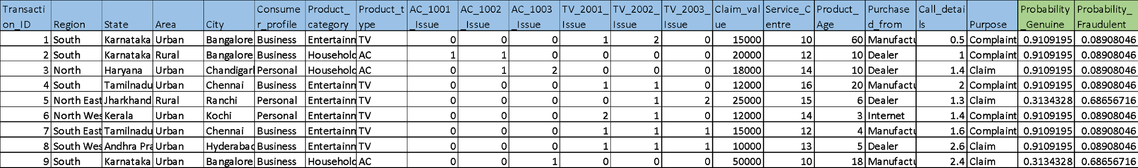
Model Predictions
Predicted probabilities for each transaction
Example
Transaction data fed to the model

Slide 14
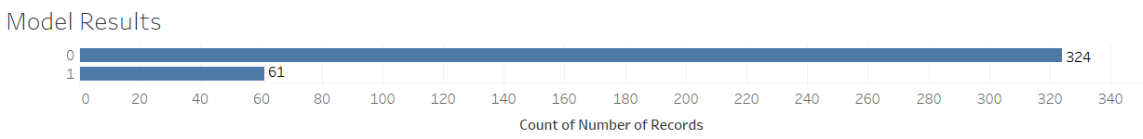
Model Results
Example
Model generated the output for the transaction data set in which 324 transactions are genuine(0) claims and 61 transaction are fraudulent(1)

Slide 15
Model Deployment using R shiny / Flask or any other method

Slide 16
Challenges faced?
How did you overcome?

